Slide 1
Crowdfunding-Tableau Dashboard

Slide 2
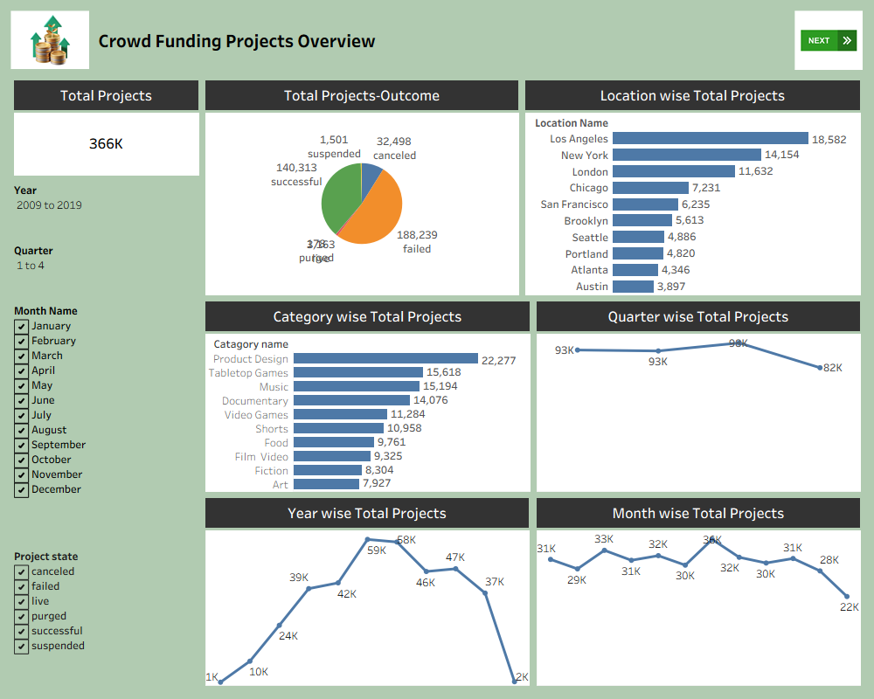

Slide 3
